Slide 1
Object Creation
Prof. Dr. Dirk Riehle
Friedrich-Alexander University Erlangen-Nürnberg
ADAP C10
Licensed under CC BY 4.0 International
Notes:
It is Friedrich-Alexander University Erlangen-Nürnberg – FAU, in short.
Corporate identity wants us to say “Friedrich-Alexander University”.

Slide 2
Design Patterns of Object Creation
Switch / Case
Factory Method
(Abstract) Factory
Product Trader
Prototype

Slide 3
Object Creation Example
Create a document from its file type (extension)
Create an application for the document

Slide 4
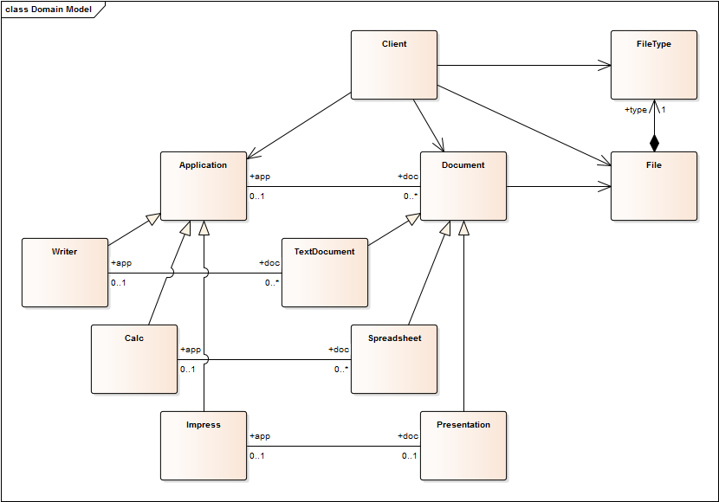
Application Document Model

Slide 5
Evaluation Criteria
Ease of
Reading code
Understanding code
Changing code
Extending code

Slide 6
Scenario 1: File-type → Document
Client is run-time environment, e.g. desktop
Wants to create document for given file

Slide 7
Switch / Case Applied
public class Client {
public Document createDocument(File file) {
String fileType = file.getFileType();
Document result = null;
if (fileType.equals("odt")) {
result = new TextDocument();
} else if (fileType.equals("ods")) {
result = new Spreadsheet();
} else if (fileType.equals("odp")) {
result = new Presentation();
}
...
return result;
}
...
}

Slide 8
Switch / Case Evaluated
Advantages
  Easy to read
  Easy to understand
  Easy to change
Disadvantages
  Hard to extend
Additional notes
  May require use of initialization method

Slide 9
Scenario 2: Application → Document
Client is run-time environment, e.g. desktop
Wants to create document for given application

Slide 10
Factory Method Applied
public abstract class Application {
public abstract Document createDocument();
...
}
public class Writer extends Application {
public Document createDocument() { return new TextDocument(); }
...
}
public class Calc extends Application {
public Document createDocument() { return new Spreadsheet(); }
...
}
public class Impress extends Application {
public Document createDocument() { return new Presentation(); }
...
}

Slide 11
Factory Method Evaluated
Advantages
  Easy to change
  Easy to extend
Disadvantages
  Creation code is not centralized any longer

Slide 12
Scenario 3: File-type → Document (v2)
Client is run-time environment, e.g. desktop
Wants to create document for given file
Wants to add new Document types in one place

Slide 13
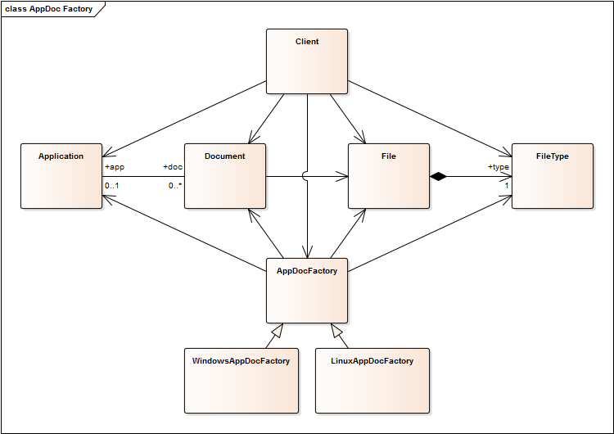
Application Document Factory

Slide 14
Abstract Factory Applied
public interface AppDocFactory {
public Application createFrom(Document doc);
public Document createFrom(File file);
...
}
public class DefaultAppDocFactory implements AppDocFactory {
...
public Document createFrom(File file) {
String fileType = file.getFileType();
if (fileType.equals("odt")) {
result = new TextDocument();
} else if ...
return result;
}
...
}

Slide 15
Abstract Factory Evaluated
Advantages
  Easy to read
  Easy to change
  Easier to extend (than v1)
Disadvantages
  Harder to understand
Additional notes
  Factories are versatile, advantages and disadvantages depend on further choices like how to implement the creation methods

Slide 16
Scenario 4: Document → Application
Client is run-time environment, e.g. desktop
Wants to create application for given document
Wants to add new Application types in one place

Slide 17
Product Trader Applied 1 / 2
public interface AppDocFactory {
public void registerApplicationClass(Class dc, Class ac);
public Application createFrom(Document doc);
...
}
public class DefaultAppDocFactory implements AppDocFactory {
Map<Class, Class> appClasses = new HashMap<Class, Class>();
static {
appClasses.put(TextDocument.class, Writer.class);
appClasses.put(Spreadsheet.class, Calc.class);
appClasses.put(Presentation.class, Impress.class);
}
...
}

Slide 18
Product Trader Applied 2 / 2
public class DefaultAppDocFactory implements AppDocFactory {
Map<Class, Class> appClasses = new HashMap<Class, Class>();
public void registerApplicationClass(Class dc, Class ac) {
assert (dc != null) && (ac != null);
appClasses.put(dc, ac);
}
public Application createFrom(Document doc) {
Class appClass = appClasses.get(doc.getClass());
assert appClass != null;
return createInstance(appClass);
}
protected Application createInstance(Class ac) {
...
}
...
}

Slide 19
Product Trader Evaluated
Advantages
  Easy to read
  Easy to change
  Easy to extend
Disadvantages
  Hard to understand
  Hard to debug
Additional notes
  Product Trader delays everything until runtime
  May be viewed as just a complex (abstract) factory

Slide 20
Scenario 5: File-type → Document (v3)
Client is run-time environment, e.g. desktop
Wants to create document for given file type
Wants to add new Document types in one place
Wants to initialize complex but default document

Slide 21
Prototype Applied 1 / 2
public interface AppDocFactory {
public void registerDocumentPrototype(FileType ft, Document doc);
public Document createFrom(FileType ft);
...
}

Slide 22
Prototype Applied 2 / 2
public class DefaultAppDocFactory implements AppDocFactory {
Map<String, Document> docProtos = new HashMap<String, Document>();
public void registerDocumentPrototype(FileType ft, Document doc) {
assert (ft != null) && (doc != null);
docProtos.put(ft, doc);
}
public Document createFrom(FileType ft) {
Document prototype = docProtos.get(ft);
assert (prototype != null) && (prototype.isCloneable());
return prototype.clone();
}
...
}

Slide 23
Prototype Evaluated
Advantages
  Easy to read
  Easy to change
  Easy to extend
Disadvantages
  Hard to understand

Slide 24
Problems with Using Design Patterns
Many design patterns address multiple issues at once, e.g.
  Factory method: Creation method and subclassing for configuration
  Abstract factory: Factory object and subclassing for configuration
  Prototype: Creation configuration and complex object structures

Slide 25
Design Process for Object Creation
Use your experience
Use a pattern language
Choose from design space
  Delegation (of object creation)
  Selection (of concrete class)
  Configuration (of class mapping)
  Instantiation (of concrete class)
  Initialization (of new object)
  Building (of object structure)

Slide 26
Design Space for Object Creation
Delegation of object creation
Selection of concrete class
Configuration of class mapping
Instantiation of concrete class
Initialization of new object
Building of object structure

Slide 27
Details of Design Space for Object Creation
Delegation (Who gets to create the object?)
  on-the-spot, this-object, separate-object
Selection (How is the concrete class selected?)
  on-the-spot, by-switch-case, by-subclassing, by-colocating, by-mapping
Configuration (How is a class mapping configured?)
  in-code, by-annotation, by-configuration-file
Instantiation (How is the concrete class instantiated?)
  in-code, by-class-object, by-prototype, by-function-object
Initialization (How is the new object initialized?)
  default, by-cloning, by-fixed-signature, by-key-value-pairs, in-second-step
Building (How is the object structure built?)
  default, by-cloning, by-building

Slide 28
1. Delegation of Object Creation
On-the-spot
  Definition: Hard-code in client code
  Use: If product class is unlikely to change, ever
By delegating to this-object
  Definition: Delegate to separate (creation) method
  Use: If this class has multiple places that need this type of new object
By delegating to a separate-object
  Definition: Delegate to a separate (factory) object
  Use: If many places in the system need to create new objects of this type

Slide 29
2. Selection of Concrete Class
On-the-spot
  Definition: Hard-code in place (whether this method, this class or factory)
  Use: If there is no need for varying the concrete class, ever
By-switch-case statement
  Definition: Hard-code in place using switch/case statement
  Use: If there are multiple options, none of which changes, ever
By-subclassing
  Definition: Select concrete class by delegating to subclass
  Use: If you need a family and dual hierarchies need to be satisfied
By-colocating
  Definition: Select concrete class as part of a family selection
  Use: If your concrete class is part of a family of co-dependent classes
By-mapping
  Definition: Look-up concrete class as part of some spec → class mapping
  Use: If your concrete class needs to be configurable at runtime

Slide 30
3. Configuration of Class Mapping
In-code
  Definition: Hard-code mapping in configuration method
  Use: If you need a mapping, but it is unlikely to change, ever
By-annotation
  Definition: Use annotations to (incrementally) configure mapping
  Use: If your mapping is small and does not need to be centralized
By-configuration-file
  Definition: Read mapping from configuration file
  Use: If you need to manage large and changing mappings

Slide 31
4. Instantiation of Concrete Class
In-code
  Definition: Call constructor (new) directly
  Use: If there is no need for configuration
By-class-object
  Definition: Represent each concrete class using its class object
  Use: If you don’t need specialized initialization
By-prototype
  Definition: Represent each concrete class using a prototype (object)
  Use: If you don’t need specialized initialization and don’t have class objects
By-function-object
  Definition: Represent each concrete class using a function object
  Use: If you need specialized initialization or don’t have class objects

Slide 32
5. Initialization of New Object
Default
  Definition: Provide a fixed (default) field assignment in constructor
  Use: If there is no need for client-specific initialization (or it can be done later)
By-cloning
  Definition: Provide a fixed field assignment by cloning a prototype
  Use: If there is no need for a client-specific initialization
By-fixed-signature
  Definition: Provide a field assignment using a fixed method signature
  Use: If you can channel everything though a fixed method signature
By-key-value-pair list
  Definition: Provide a field assignment using a variable argument list
  Use: If considerable variation is possible and needed in object initialization
In-second-step
  Definition: Push back object initialization to client until after creation finished
  Use: If there is too much variation in the initialization arguments

Slide 33
6. Building of Object Structure
Default
  Definition: Let the new object create any dependent object structure
  Use: If the client wants no say in creating any dependent objects
By-cloning
  Definition: Create the desired object structure by cloning a prototype
  Use: If someone else needs to define the object structure for the client
By-building
  Definition: Create the desired object structure by building it piece-by-piece
  Use: If the client needs to direct the building of a complex object structure

Slide 34
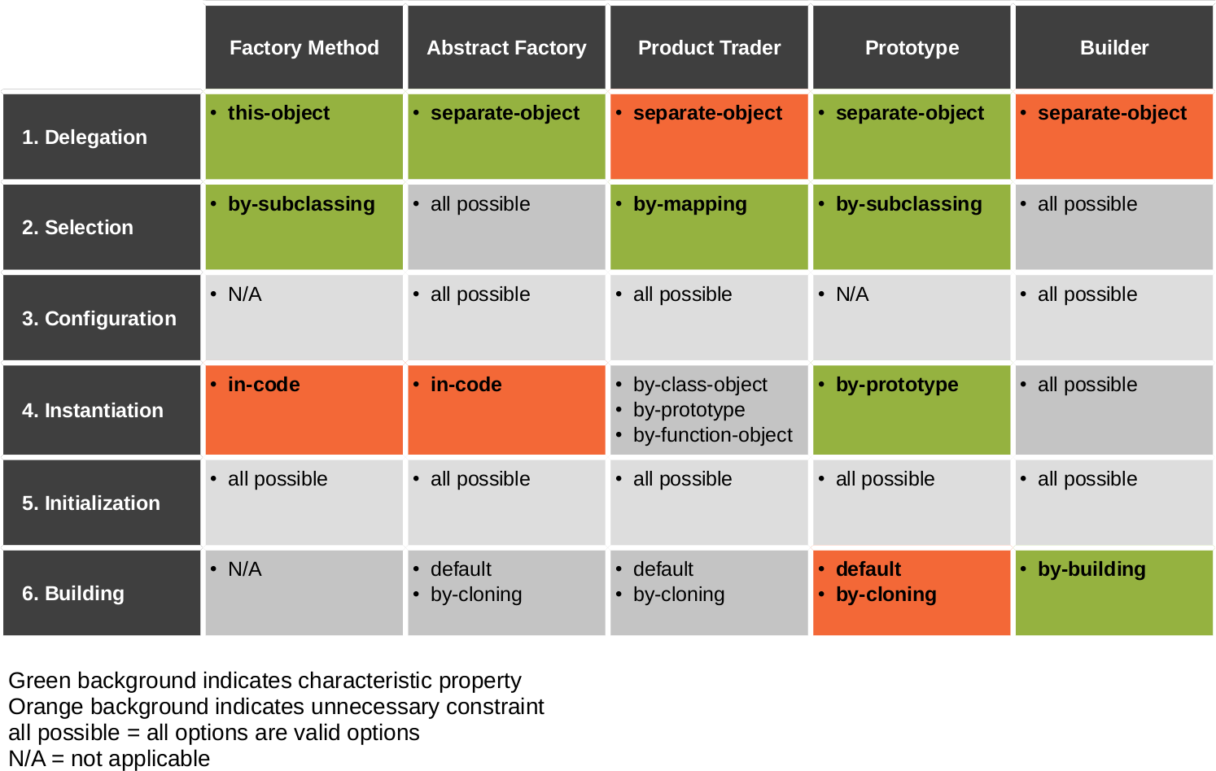
Design Patterns and Design Space

Slide 35
Review / Summary of Session
Object creation patterns
  Several patterns, definitions, examples
    Switch / case
    Factory method
    Abstract factory
    Product trader
    Prototype
    Builder
  Constituting a design space

Slide 36
Thanks! Questions?
dirk.riehle@fau.de – http://osr.cs.fau.de
dirk@riehle.org – http://dirkriehle.com – @dirkriehle
DR

Slide 37
Credits and License
Original version
  © 2012-2018 Dirk Riehle, some rights reserved
  Licensed under Creative Commons Attribution 4.0 International License
Contributions
  ...

